Slide 1
Amazon Sales Data Analysis
R Shashikiran

Slide 2
Objective: Sales management has gained importance to meet increasing competition and the need for improved methods of distribution to reduce cost and to increase profits.
Benefits:
Determine Sales trend, monthly, yearly
KPI(key performance index) like profit, profit%, customer retention rate, discount, sales quantity, sales amount

Slide 3
Data Sharing Agreement
File name: SALESDATA.xlsx
Number of columns: 22
Column Names: CustKey, DateKey, Discount Amount, Invoice Date, Invoice Number, Item Class, Item Number, Item, Line Number, List Price, Order Number, Promised Delivery, Sales Amount, Sales Amount based on list price, Sales Cost Amount, Sales Margin Amount, Sales Price, Sales Quantity, Sales Rep, U/M
Column data type: Numerical and Categorical.

Slide 4
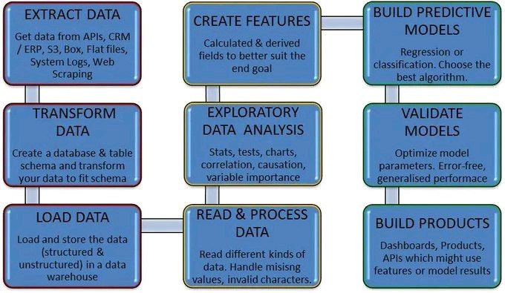
Architecture

Slide 5
EDA
Below points are considered in EDA
Missing Values Column Item class has > 8k missing values.
Exploring Numerical Variables Discount Amount, List Price, Sales Amount, Sales Amount based on List Price, Sales Cost Amount, Sales Margin Amount, Sales Price, Sales Quantity.
Exploring Categorical Variables CustKey, DateKey, Invoice Date, Invoice Number, Item Class, Item Number, Item, Line Number, Order Number, Promised Delivery, Sales Rep
Finding Relationship between features

Slide 6
BI tool used: PowerBi
Loaded the SALESDATA.xlsx in PowerBi
Prepared DAX queries
Slicers used are Item, Month, Year
Prepared dashboard to showcase KPI’s such as profit amount , profit%, sales amount, sales quantity, Total Sales, Top product based on sales amount, top product based on profit%.
Included Bar chart for Month vs Sales Amount & profit.
Included Area chart depicting total sales across days.

Slide 7
Contd..
New table sales trend is created
In Sales trend the columns created are Date, month, Month num, Quarternum , Year, day
In Data modelling, Sales trend is mapped with Amazon Sales data using Many to One cardinality.
Various measure were created using DAX such as Customer Retention Rate, Total Sales, Profit %, Top product sold

Slide 8
Insights
In 2017, the sales amount was 87.46M which is higher when compared with rest of the years.
In 2018 ,the sales amount was 20.82M which was lowest when compared with rest of years.
Profit in 2017 was highest with 37.42M and in 2018 was lowest with 9.15M.
Overall top product sold based on sales amount is LANDSLIDE WHITE SUGAR.
Overall top product sold based on profit% is Atomic mint chocolate bar.

Slide 9
Q n A
What is the source of data?
The data was shared by the client and was stored in MYSQL server database
What is the type of data?
It contains both numerical and categorical types
What are the KPIs used?
Some important KPIs are profit, profit%, sales amount, sales quantity, customer retention rate. On yearly and monthly basis

Slide 10
Contd…
Can you show sales forecast using the existing data?
Yes upto next 3-5 years with good accuracy
What is the flow of this project?
First we have extracted the data from data base, performed EDA and data cleansing in Python and then built the final dashboard in PowerBi.

